Slide 1

NLP-Based Resume Parsing and Skills Extraction
Ranjith James Satvik Kundargi Andria Grace Sathwik kuchana

Slide 2
Introduction
Streamline recruitment by automating resume processing, skill extraction, and candidate-job matching.
Objective:
Automate Resume Processing
Extract and Analyze Key Skills
Match Candidates to Job Descriptions

Slide 3
Main Components
Resume Parsing: Extract text from various formats (PDF, DOCX)
Skill Extraction: Identify key skills using NLP techniques
Matching Algorithm: Align skills with job descriptions and rank candidates
User Interface: Easy-to-use platform for HR professionals to manage resumes and job descriptions.

Slide 4
Timeline and Assumptions
Project milestones: Data collection, model training, testing, deployment
Assumptions: Availability of quality resumes, accuracy of skill extraction
Timeline: 7 weeks from start to finish
Week 1: Planning & Data Collection Week 2: Data Preprocessing Week 3: Model Development Week 4: Integration & UI Development
Week 5: Testing Week 6: UI Enhancement Week 7: Final Testing & Deployment

Slide 5
Dataset
Dataset URL: Kaggle Resume Dataset
Dataset Composition:
Total Resumes: More than 2,400 resumes
Formats: Available as both text within a CSV file and as PDF documents
CSV File: Includes resumes in text format and associated metadata
ID: A unique identifier for each resume, corresponding to the PDF filename
Resume_str: The text content of the resume
Resume_html: Resume data in HTML format, derived from web scraping
Category: The job category associated with each resume
PDF Documents:
Storage: Organized in a data folder, divided into subfolders by job category
Naming Convention: Each PDF is named using its unique ID for easy reference
This dataset provides a rich resource for developing and testing NLP models for tasks such as resume parsing, job matching, and recruitment analytics.

Slide 6
Design Summary
Data Ingestion: Handles input resumes
Resume Parsing: Extracts structured data from resumes
Skill Extraction: Identifies and extracts skills from the parsed data
Model Training: Trains the model for job matching
User Interface: Provides an interactive interface for users

Slide 7
Methodology
Data Ingestion: The system ingests resumes from various formats into a structured format for further processing
Reading Resumes: Utilizes PyPDF2 to process PDF resumes
Conversion: Converts PDF content into a structured format for ease of parsing
Resume Parsing: Parses resumes to extract text and relevant sections such as experience, education, and skills.
NLP Tasks: Uses spaCy for tokenization, Named Entity Recognition (NER)
Section Extraction: Identifies and extracts key sections from the resume text for further analysis

Slide 8
Methodology
Skill Extraction
Extracts skills from parsed text using predefined skill patterns.
Pattern Matching: Utilizes a JSON file containing patterns to identify skills and compares text against skill patterns defined in Skill_patterns.json
Normalization: Extracts and normalizes skill names for consistency

Slide 9
Model Training
Training a machine learning model to match resumes with job descriptions.
Data Preparation: Cleans and prepares data for model training
Feature Extraction: Extracts relevant features from resumes and job descriptions
Model Training: Employs various algorithms to train the matching model
Evaluation: Assesses model performance using metrics such as precision, recall, and F1-score

Slide 10
User Interface
User Interface - HR Application
An interactive HR application for managing resumes and job matches.
Interface: Built using Gradio for a user-friendly experience
Features: Allows uploading resumes, viewing parsed data, and matching candidates to jobs
User Interface - User Application
A user-facing application that allows candidates to upload their resumes and receive feedback.
Resume Upload: Enables candidates to upload their resumes
Feedback: Provides feedback on skills and job matches based on the parsed data

Slide 11
Requirements and Dependencies
spaCy: For NLP tasks
nltk: For additional NLP functionality
jsonlines: For handling JSON Lines files
requests: For making HTTP requests
PyPDF2: For PDF processing
gradio: For building interactive ML Interface

Slide 12
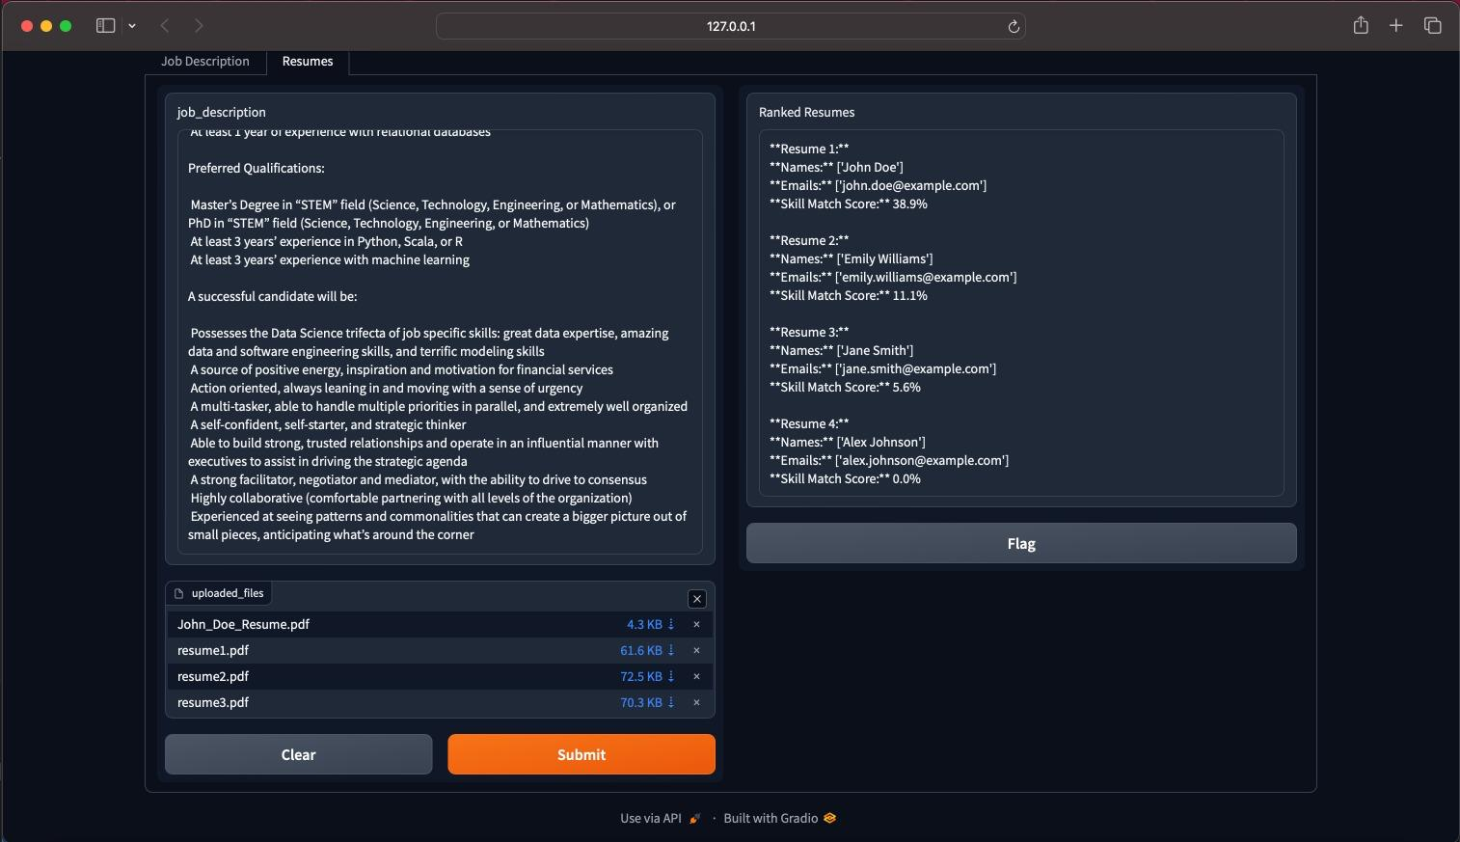
Solution Demo ( Live )
Solution Demo

Slide 13
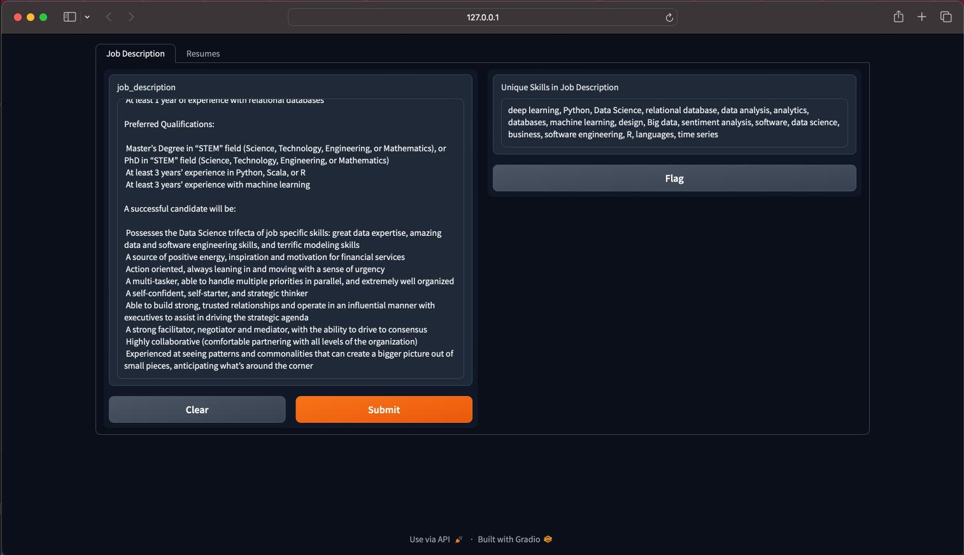

Slide 14
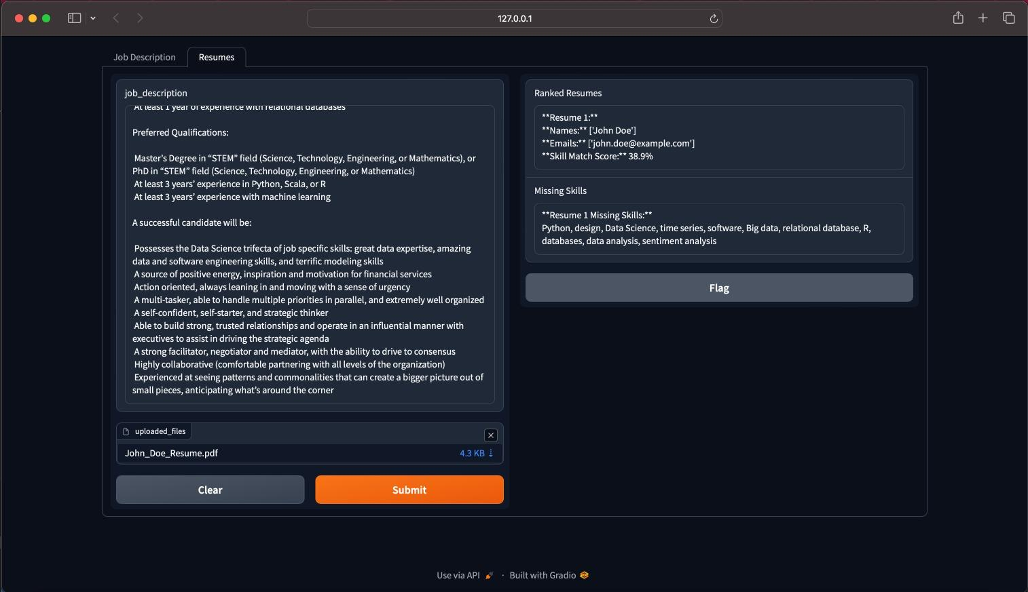

Slide 15
Findings
Performance Metrics: Evaluated on precision (98%), recall (91%), and F1-score (95%)
Resume Parsing: High accuracy in extracting key information (e.g., names, skills, experience), with slightly lower performance in context-dependent fields
Job Matching: Good accuracy in ranking candidates, with semantic analysis providing a nuanced understanding of qualifications
Probable Impact: Reduce candidate selection time by upto 50%, improves accuracy, and reduces human biases, which can lead to more efficient and fair recruitment

Slide 16
Model Improvements
Model | Precision | Recall | F1-Score
en_core_web_md (Base Model) | 95% | 84% | 89%
en_core_web_md (Fine Tuned Model) | 98% | 91% | 95%

Slide 17
Conclusion
System Purpose:
Enhances recruitment by automating and optimizing resume processing
Improves candidate-job matching using NLP techniques
Benefits:
Addresses biases in traditional hiring
Increases efficiency in the recruitment process
Challenges:
Diverse resume formats.
Industry-specific needs.
Ethical concerns around AI fairness.

Slide 18
Future Work
Expand Training Data: Incorporate more diverse resume formats and industry-specific data to enhance model accuracy
Adaptability: Improve the system's handling of non-traditional resumes and niche job roles
Ethical Considerations: Continuously monitor and address bias, ensuring fairness and transparency in AI-driven recruitment
User-Centric Enhancements: Tailor resume suggestions more closely to specific job markets and employer preferences
Integrate LLM’s: To suggest Resume Enhacements automatically based on missing skills

Slide 19
THANK YOU

